Slide 1

Indian Society for technical education
Working with APIs

Slide 2

What is an API
API is the acronym for Application Programming Interface, which is a software intermediary that allows two applications to talk to each other.
When you use an application on your mobile phone, the application connects to the Internet and sends data to a server. The server then retrieves that data, interprets it, performs the necessary actions and sends it back to your phone.

Slide 3
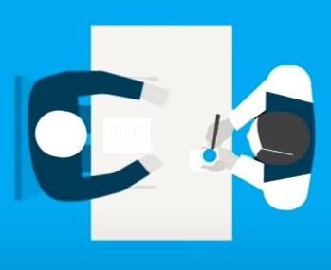
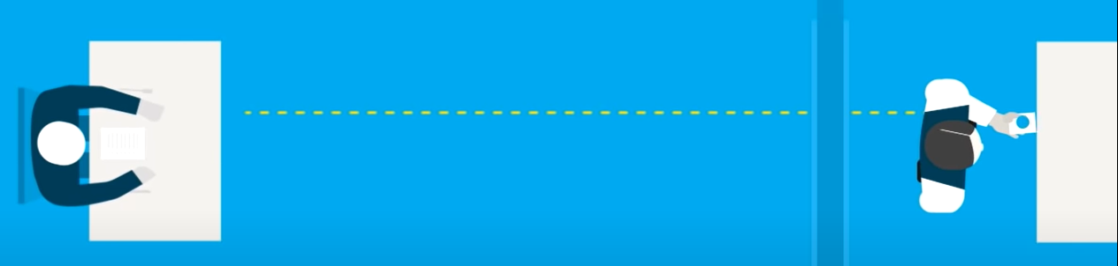
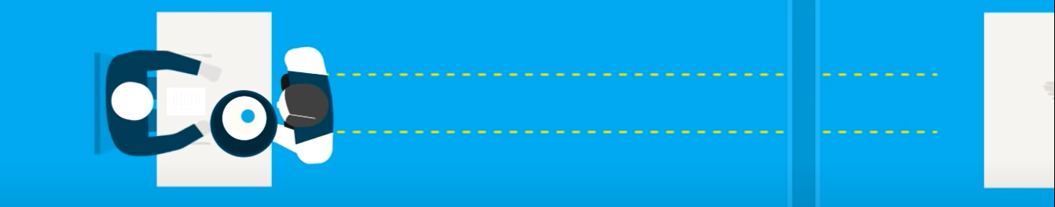
An example to understand API
API
API/waiter takes the request of the customer to the server/kitchen
User
API/waiter takes the result from the server/kitchen to the customer.

Slide 4
Where is API used ?
View your flight ticket booking details.
Stream the YouTube video you’ll watch.
Displaying the maps of your location.
Store and read the tweets you have posted.
Pull data for tracking Coronavirus outbreak worldwide.

Slide 5
What is a JSON file
JavaScript Object Notation (JSON) is an open standard file format, and data interchange format, that uses human-readable text to store and transmit data objects consisting of attribute–value pairs and array data types (or any other serializable value).
When exchanging data between a browser and a server, the data can only be text.
JSON is text, and we can convert any JavaScript object into JSON, and send JSON to the server.
We can also convert any JSON received from the server into JavaScript objects.
This way we can work with the data as JavaScript objects, with no complicated parsing and translations.

Slide 6
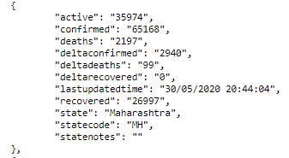
An example of a JSON file
A JSON array of data regarding the coronavirus situation of Maharashtra.

Slide 7
Advantages of JSON
Fast and has easy to use syntax.
Compatible to world wide web browsers.
JSON’s server-side parsing is very fast and hence gives the users quick responses.
The best tool to share data.

Slide 8
How will we use API and JSON file in our project
For our webinar we will take an API which has a JSON file which contains the data about the weather parameters of the city we need to get from the server.
We will pull the JSON file from the server and extract data from it and display it on our web page.

Slide 9
fetch() function
The fetch() function is required to fetch or get the JSON file from the server or the API that we will use. Fetch provides a generic definition of Request and Response objects (and other things involved with network requests). This will allow them to be used wherever they are needed in the future, whether it’s for service workers, Cache API, and other similar things that handle or modify requests and responses, or any kind of use case that might require you to generate your own responses programmatically

Slide 10
The Weather Monitor
For the weather monitor we will be using a weather API which contains the data of weather conditions of the required city that we want to display details about. From the API we will pull the JSON file in which that data is present. From the JSON file the parameters of temperature and humidity will be displayed below the city name.

Slide 11
Thank You

Slide 12

Indian Society For Technical Education
istevit.in
instagram.com/iste_vit_vellore
facebook.com/ISTE.VIT
linkedin.com/company/indian-society-for-technical-education
github.com/ISTE-VIT
About Me
Lakshit Kothari
@l.k.1.2
www.linkedin.com/in/lakshit-kothari-6569531a1

